Slide 1
The A Team
Diet Manager V2.0 Presentation

Slide 2
Members
Roy Tran
Brianna Buttaccio
Kevin Reynolds
Fu Quan Li
Tiffany Ellis
Caitlyn Daly

Slide 3
Summary
The project’s goal is to create an application that allows a user to keep track of personal health information. This information is important to users who wish to begin or maintain a healthy lifestyle. The ideal use of this application will have users update their information on a daily basis.

Slide 4
Approach - MVC Pattern
Approach - MVC Pattern
View - It will know about and be able to call on other classes that will act as widgets that can be reused in different parts of the program. These widgets will include a line graph, food consumption list, food and recipe addition and deletion, and a delete button.
Controller - The User Log Manager and Food List Manager are classes that act as our controllers. They will handle all of the logical functionality that comes with the user's nutritional, daily log data and food and recipe data respectively.
Model - Each class is in charge of recording their respective data. The model uses the Observable pattern so that the view can update the display when data changes in the model. All of these files are use the controller to handle the logic and business rules of changing data.

Slide 5
Design Patterns
MVC (Model-View-Controller)
Model
The model is the central component of the pattern.
It expresses the application's behavior, independent of the user interface. It directly manages the data, logic and rules of the application.
View
The GUI
The part of the program that is in change of displaying the information.
Controller
Sends commands to the model to update its states
Sends commands to the view to update its displays

Slide 6
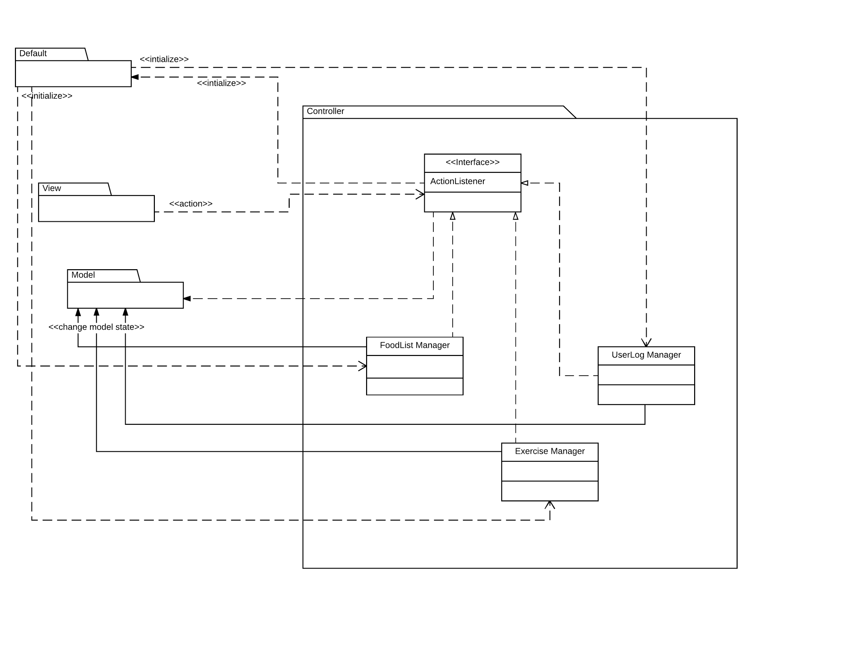

Slide 7
Design Patterns
Observer / Observable
Observer
any object that wishes to be notified when the state of another object changes
Observable
any object whose state may be of interest, and in whom another object may register an interest

Slide 8
Design Patterns
Composite Pattern
Composites that contain Components, each of which could be a Composite.
Component
declares the interface for objects in the composition
is the abstraction for all components, including composite ones
Food Class
Composite
Has children
implements methods to manipulate children
Recipe Class
Leaf
implements all Component methods
Basic Foods class

Slide 9
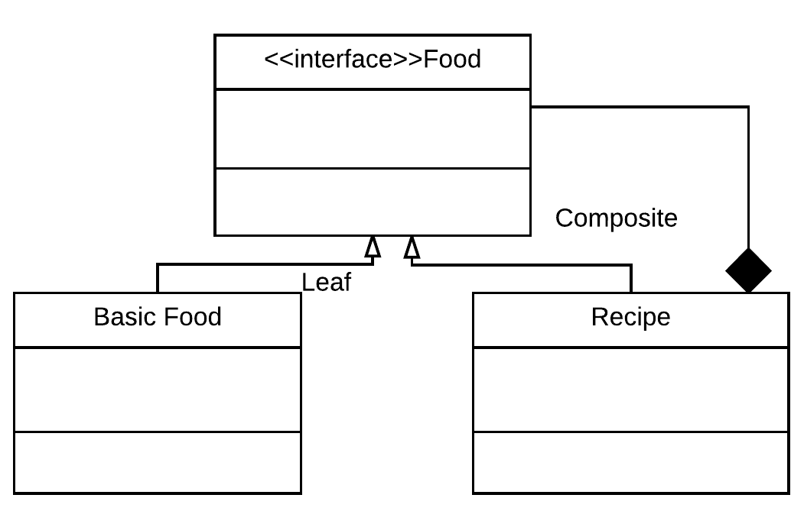

Slide 10
Design Patterns
Programmed to Interface
"Programming to an interface" means, that when possible, one should refer to a more abstract level of a class (an interface, abstract class, or sometimes a superclass of some sort), instead of refering to a concrete implementation.
IOInterface - CSVIO programmed to IOInterface
Allows us to change the way the data is stored easily
CSVIO - Takes care of reading in and writing to the csv

Slide 11
Design Pattern Summary
MVC
Why: There is a clearly defined separation between components of a program -- problems in each domain can be solved independently.
Leads to lower coupling and higher cohesion
Observer / Observable Pattern
Why: Allows us to have data updated as the user is inputting data
Composite Pattern
Why: Allows us to compose our objects into a tree structure to create our food, basic food and recipe objects
Programming to Interface
Why: Allows us to increase cohesion and separation of concerns, therefor in the future only one class has to be added to the program each time the “database” changes

Slide 12
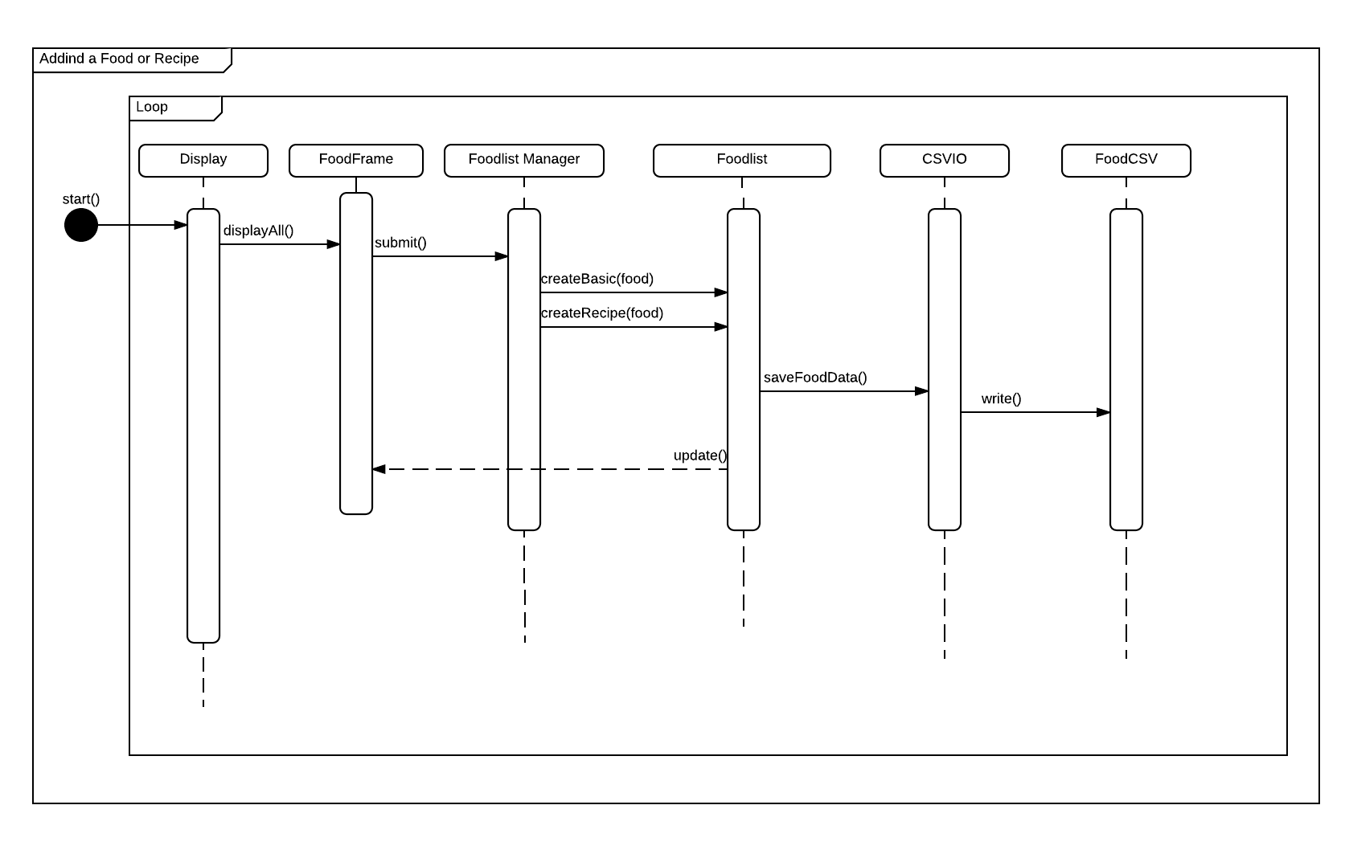
Sequence Diagram - adding recipe to Food Collection

Slide 13
Design Decisions : The Good
Implementation of the Observer Pattern
Programming to Interface for CSV
Good separation of concerns

Slide 14
Design Decisions: The Bad
Naming Conventions
Not following the Design when Coding
Keeping Track of tasks and dividing them well

Slide 15
Demo Time!

